Slide 1

Predictive Analytics for Strategic Student Retention
Reducing Dropout Rates and Maximizing Institutional ROI

Slide 2
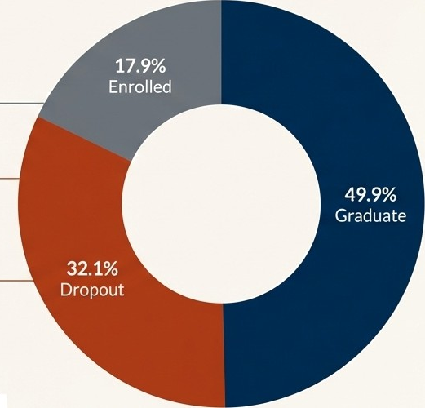
The Challenge: Student Attrition Represents a Significant Institutional Risk
Student attrition leads to substantial revenue loss and impacts institutional prestige. Our traditional approach is reactive, often intervening only after a student is already failing.
49.9% Graduate: The desired outcome.
32.1% Dropout: A significant loss of talent and revenue. For every 10 students who graduate, more than 6 drop out.
17.9% Enrolled: The cohort whose future is still uncertain,
representing both risk and opportunity.
The key opportunity is to shift from a reactive to a proactive
model, using data to anticipate risk before it becomes critical.

Slide 3



The Opportunity: A Proactive, Data-Driven
Approach to Student Success
Core Objective: To build a system that proactively identifies at-risk students, enabling timely, targeted, and effective interventions.
Early Identification | Resource Optimisation | Improved Outcomes
Flag potential issues in the | Focus the limited time of | Increase retention and
first or second semester, | faculty and counsellors on | graduation rates, directly
when support can have the | the students who require | boosting institutional financial
greatest impact. | support the most. | health and reputation.

Slide 4



Our Solution: The Student Success Prediction Model
We have developed a machine learning model that acts as an early-warning system. It analyses a student's data profile to accurately calculate their probability of graduating or dropping out.
INPUT
Historical Student Data (Demographics, Academic History, Enrolment Data)
PROCESS
Machine Learning
Model
(Predicts Future
Outcomes)
OUTPUT
Actionable Risk Score (Probability of Dropout/Graduation)

Slide 5
The Foundation: Built on a Rich, Multi-Modal Student Dataset
OO
Demographic Profile: Marital status, nationality, age at enrolment.
Data Source: Analysis is based on a real-world academic success dataset comprising 4,424 undergraduate students.
Socio-Economic Background: Parents' qualifications and occupations.
Prior Academic Record: Previous qualifications and admission grades.
Data Richness: The model is powered by 37 distinct features for each student, covering a wide range of factors.
Enrolment Course Data: Application mode, course of study.
First & Second Semester Performance: A detailed breakdown of curricular units (enrolled, approved, credited, grades, evaluations).

Slide 6
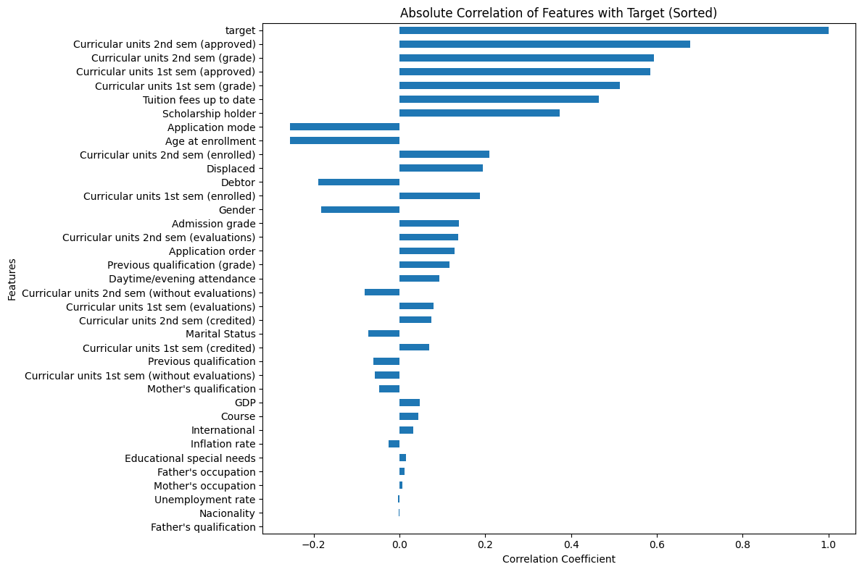
Uncovering the Key Predictors of Success
Our analysis reveals that early academic performance is the single most powerful
predictor of student outcomes. The model's logic is transparent and intuitive.
Strongest Positive Correlation The number of curricular units a student passes in their second and first semesters.
Other Key Factors
Timely payment of tuition fees and holding a scholarship are also strongly associated with graduation.
Strongest Negative Correlation
Being Application Mode and Age at Enrollment shows a correlation with dropping out.

Slide 7
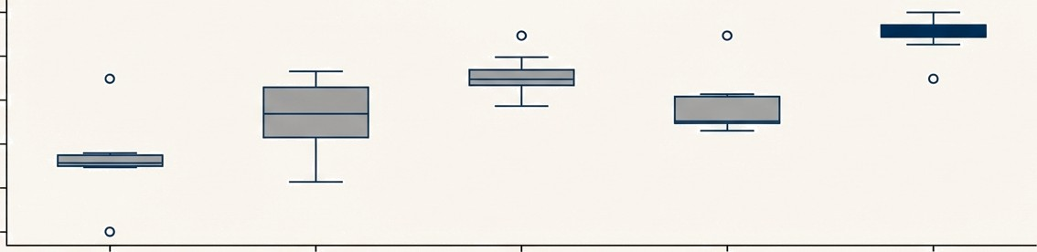
Engineering the Optimal Model Through Rigorous Evaluation
We trained and benchmarked five industry-standard machine learning models to identify the most effective and reliable predictor for our specific dataset.
Models Tested: Logistic Regression, Decision Tree, Random Forest, XGBoost, and Support Vector Machine
(SVM).
Cross-Validation Recall Scores
0.96
0.94
0.92
0.90
0.88
0.86
Recall
Logistic Regression Decision Tree
Random Forest XGBoost
SVM
Conclusion: The Support Vector Machine(SVM) model consistently demonstrated superior performance, particularly in its ability to correctly identify at-risk students(Recall), making it our chosen engine.

Slide 8






Performance in Focus: Accuracy We Can Trust for Intervention
For an early-warning system, the most critical metric is Recall. We must minimize the number of at-risk students we fail to identify(false negatives). A high Recall score ensures our interventions reach the right people.
Recall Score for’Dropout’
Business translation: Our model successfully identifies 95 out of every 100 students who are genuinely at risk of dropping out. This dramatically reduces the chance that a student in need of support is overlooked.
Precision Score for‘Dropout’
Business translation: When the model flags a student as 'at-risk’, it is correct 84% of the time, ensuring that counsellor time is focused effectively with minimal false alarms.

Slide 9
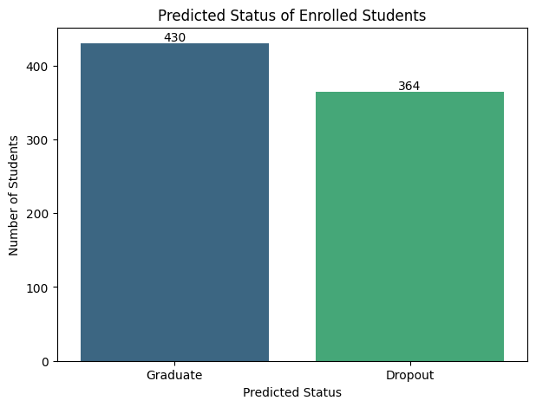

From Prediction to Actionable Intelligence
We applied the trained model to the currently enrolled student population to identify those most in need of immediate support.
currently enrolled students identified
with a high probability of dropping out.
This is no longer a historical analysis; it is a live, prioritized list for student
support services to begin targeted outreach today.

Slide 10
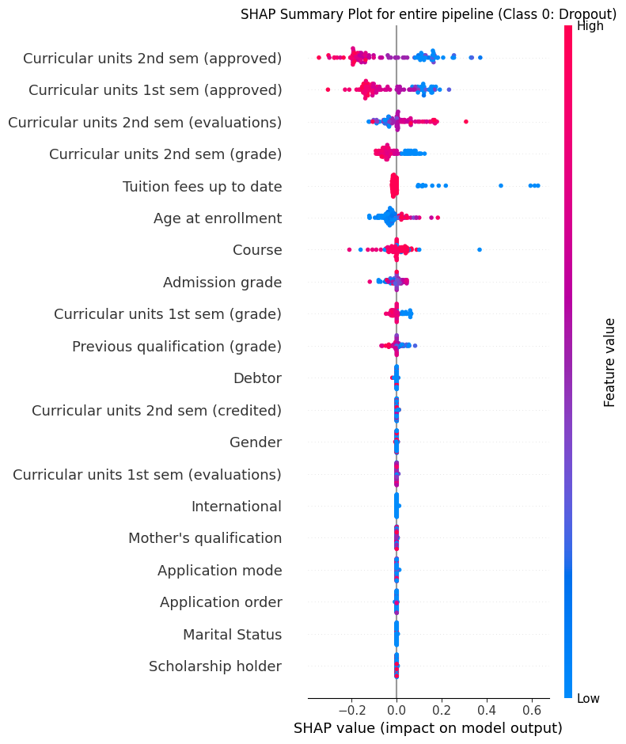
Understanding the ‘Why’ Behind the Risk at Scale
The model doesn't just tell us who is at risk; using SHAP analysis, it can tell us why. This allows us to see the systemic factors that influence student success across the entire population.
How to Read the Chart
Target class: Class 0 = Dropout
Y-axis: Features ranked by importance (top = most influential)
X-axis: SHAP value = impact on model output (positive = pushes toward dropout, negative = pushes away)
Dots: Each dot = one student
Color: Feature value (blue = low, red = high)
Position: SHAP value (left = pushes toward dropout, right = pushes away)
Strategic Insight
Poor academic performance in the second semester (e.g., low grades, fewer approved units) is consistently the strongest factor pushing students towards dropping out. This suggests focusing intervention resources at this critical juncture.

Slide 11
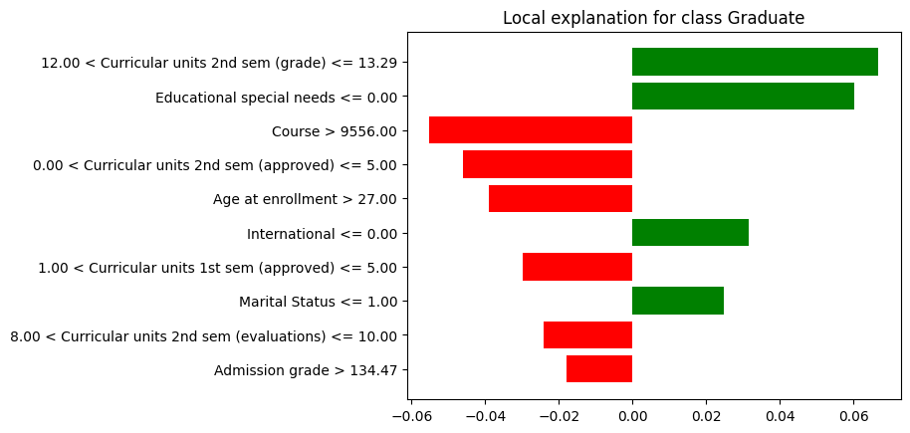
A Case Study: Empowering Evidence-Based Advising
Consider a single student flagged by the model as being at high risk of dropping out. Instead of a generic alert, the advisor receives a detailed diagnostic profile.
The Diagnostic Insight:
The LIME analysis shows us exactly why this student is at risk. The primary drivers are:
A low number of approved units in
the 2nd semester.
An enrolment age greater than 27.
Enrolment in a specific course
(9556).
The Actionable Outcome: This allows an advisor to have a highly specific conversation about academic load, potential external pressures related to age, and course-specific support, rather than a generic“How are things going?“

Slide 12



The Result: A Sustainable Strategic Advantage
Proactive Intervention | Optimised Resource Allocation | Maximised Return on Investment
Shift from waiting for | Focus the valuable time of | Every student retained
students to fail to preventing | counsellors and support staff | represents preserved tuition
failure. Intervene based on | on the 364 students | revenue. Every graduate
predictive risk, not lagging | identified as needing it most, | boosts the institution's official
indicators. | increasing the efficiency and impact of support services. | graduation rate metrics, enhancing reputation and rankings.

Slide 13



Recommendations and Next Steps
We recommend a phased implementation to integrate this predictive capability into our student support framework.
Immediate Next 3-6 Months Next 6-9 Months
Pilot
Program
Launch a targeted intervention pilot with the Student Affairs office, focusing on the 364 students identified by the model. Track engagement and outcomes.
System Integration
Work with IT to integrate model outputs (risk scores and key risk factors) into the existing student advisory dashboard to make this data accessible in real-time.
Develop Playbooks
Create targeted intervention playbooks for advisors based on the primary risk factors identified by the model (e.g., specific protocols for academic load issues vs. financial pressures).

Slide 14
From Insight to Impact
The Student Success Prediction Model provides the university with a powerful new capability. It allows us to move beyond intuition and traditional metrics to a truly data-driven strategy for student retention. By understanding not just who is at risk, but why, we can ensure that every student has the optimal support structure to succeed.

